Slide 1
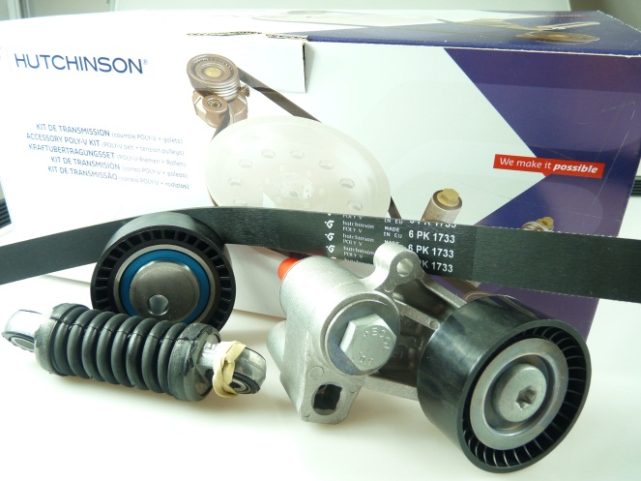

N° 002 09/2014
Automotive spare parts
Rechange automobile
COMMERCIAL Newsletter
Bulletin d’information COMMERCIAL
TAkE ADVANTAGE OF YOUR ACCESSORY BELT CHANGE TO CHANGE YOUR IDLERS AND TENSIONERS.
‣ Idlers and tensioners are wear parts and have a limited life time.
Take advantage to change the idlers and tensioners.
‣ It is recommended to proceed to the remplacement of idlers and tensioners at the same time as the belt.
To reduce the global cost parts, use the Poly V Kit Hutchinson.
A complete range of 162 references covering the most common applications.

